Slide 1
Engine room
Mud pump room
Sack storage room
Air compressor room
Switchboard room
Cantilever
Drill floor + Derek
Main deck (Port & stbd)
Mess room
Helideck

Slide 2
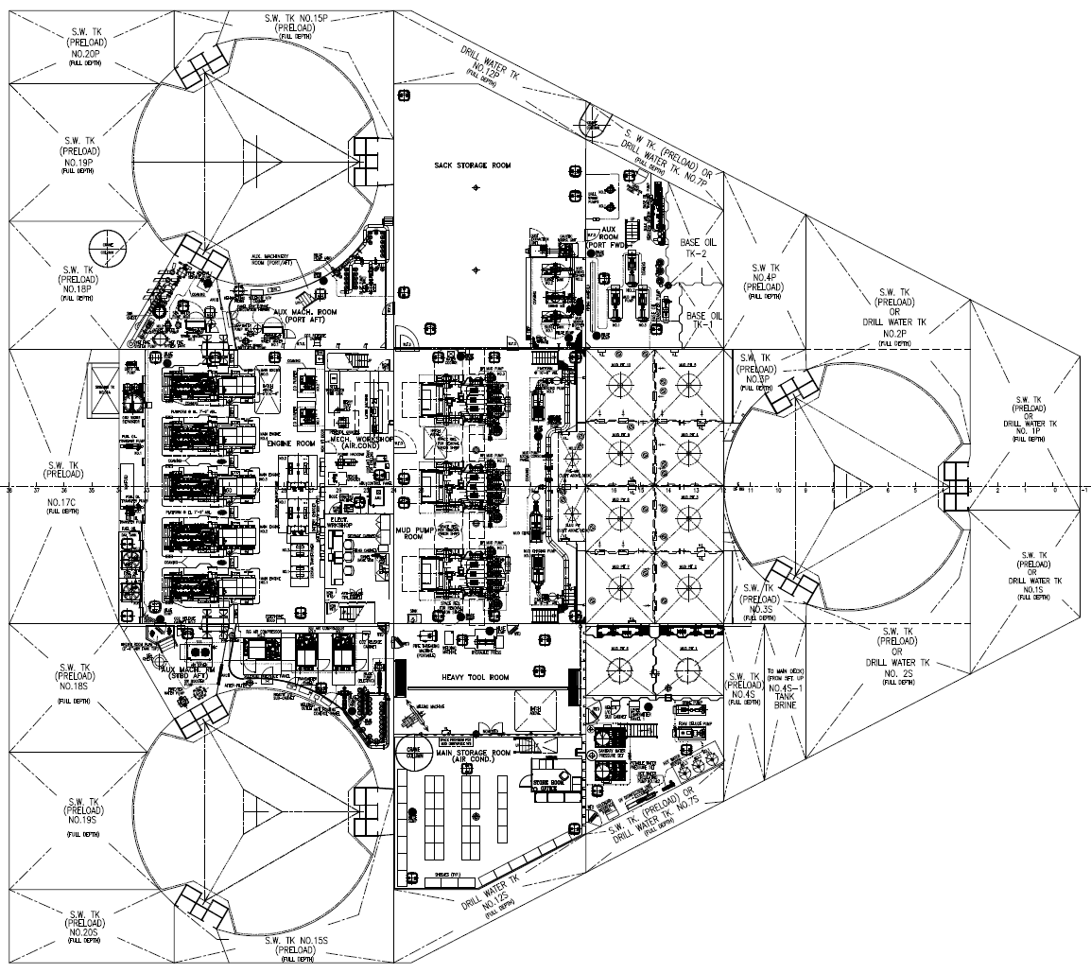
3
1
2
4

Slide 3
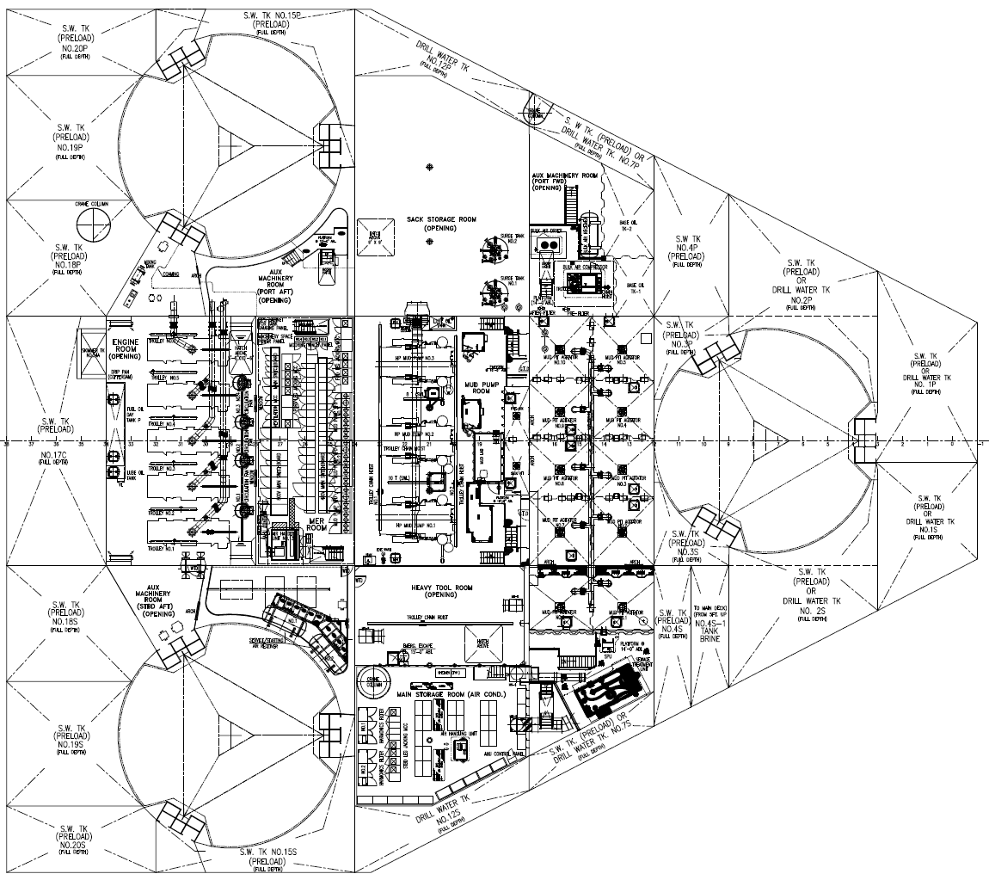
5

Slide 4
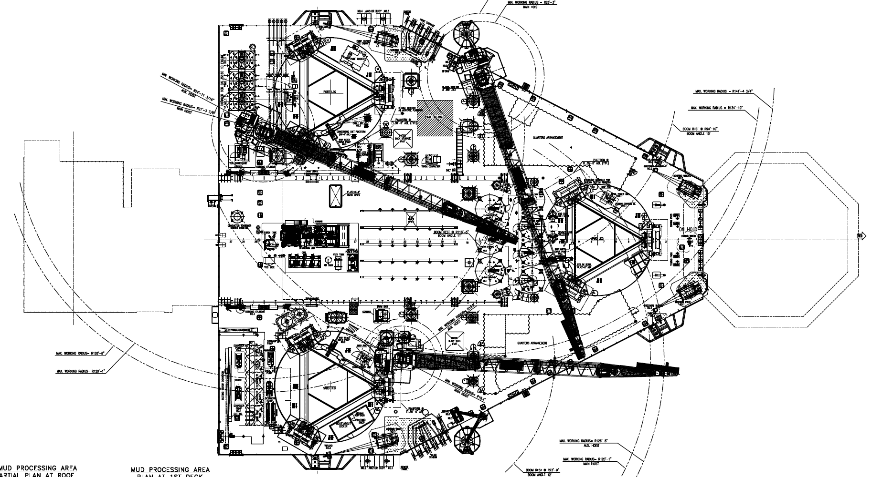
6
10

Slide 5
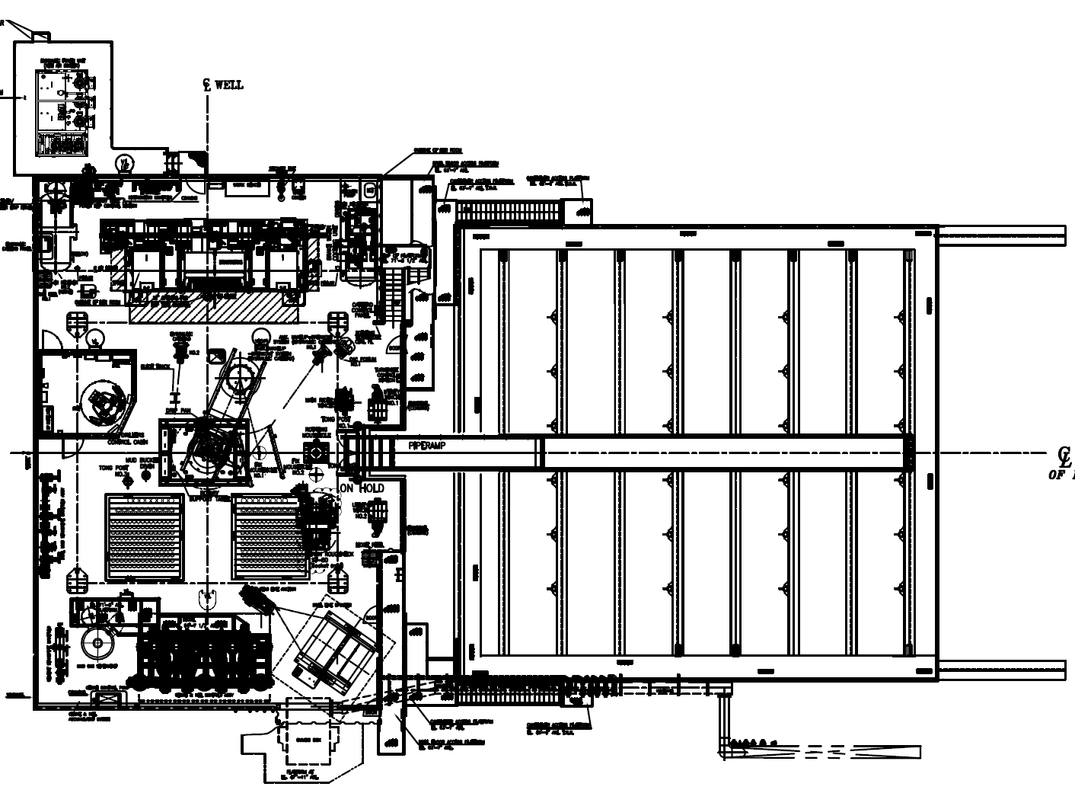
8
7
8

Slide 6
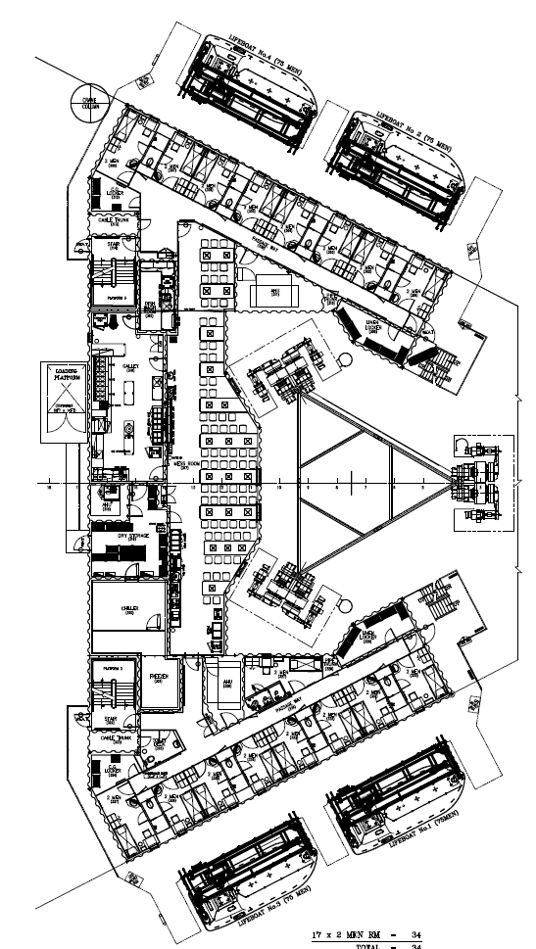
9

